Slide 2
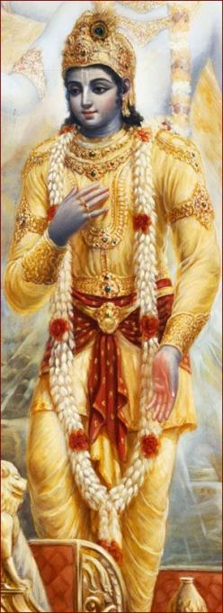
The Glories
of
Merciful Purusottama Month

Slide 3
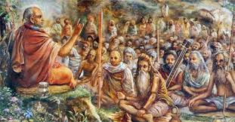
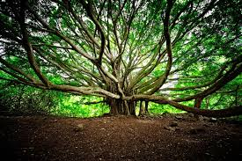
“Merciful Purusottama month acts like a desire tree to fulfill a devotee's desire.”
–The Sages of Naimisaranya-

Slide 4
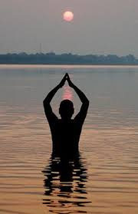
"Just by bathing in a holy river during Purusottama month, one becomes sinless. The glory of all other months is not equal to one-sixteenth of the glory of the Purusottama month. By bathing in a holy place, giving charity and chanting the Holy Name Krsna during Purusottama month, all miseries are destroyed, one attains all kinds of perfection and fulfills all his desires.” – Durvasa Muni

Slide 5
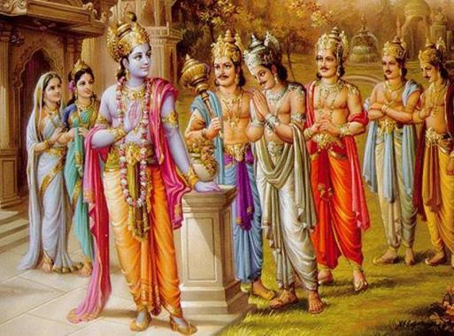
Purusottama Month Pastime
Once while the Pandavas were exiled, Lord Krsna went to visit them in the forest. Being pleased with their love and devotion, he narrated the history of Purusottama Month

Slide 6
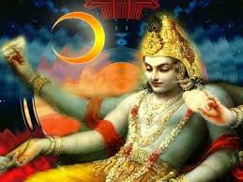
By the arrangement of the Providence an extra month came into this world. However, it was considered to be an extremely inauspicious time to perform any religious activities.
The personality of this month, being so rejected by everyone became grief stricken and decided to approach the Lord to explain the sorrowful situation. It fell at the Lord’s lotus feet saying “My Lord you are an ocean of mercy. I have no other shelter than you.
Please protect me. Please show me your mercy!”

Slide 7
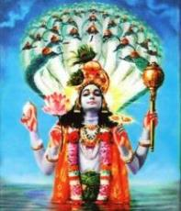
Saying these words, the extra month [adhik maas] began to cry and sat down before the Supreme Lord in a dejected mood. The all merciful Lord Krsna said, “Do not lament, I shall give you protection from all of your miseries. Please stop crying. It is not proper to lament after taking shelter of My lotus feet.”
"I shall make you just like Me in quality, fame, opulence, realization, success, and in giving benediction to the devotees. This month will become equally potent to Me. I am bestowing all of My divine qualities in this abused month. Named after Me, this month will be famous as Purusottama month in this world" – Lord Krsna (Padma Purana)

Slide 8
How to Observe Purusottama Month
Wake up before sunrise and attend Mangal Artik
Perform Tulsi Puja & Parikrama
Chant Japa
Chant Extra Rounds
Take Ganga Bath
Offer Flowers to Lord Krsna
Offering Tulasi/ Manjaris
Participate in Sandhya / other Artiks
Offering Lamp
Attend Srimad Bhagavatam Class
Read about Krishna (SB, BG./ others)
Participate in Preaching Programs
Offering 1-16 Items of Worship (Upacaras)
Attend / Organize Home Programs
Participate in Harinams
Distribute Books
Perform Vaisnava Seva
Perform Temple Seva
Attend / Organize Bhajans /Sangas

Slide 9
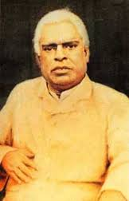
Srila Bhaktivinoda Thakura recommends devotees to observe Purusottama Month according to their individual capacity

Slide 10
The Special Months
Purusottama, Vaisak and Damodara (Kartika) months are special occasions manifested particularly to give mercy to non-devotees
These items for honoring Purusottama month are directly taken from the Puranas and according to Srila Prabhupada’s directives regarding attracting newcomers to Krishna Consciousness (preaching, Harinams, book distribution, etc.) during this kind of special months.
Srila Prabhupada explains the purpose of such months in a letter to H.H. Jayapataka Swami (at that time a Brahmacari) on January 30, 1969 (Next slide).

Slide 11
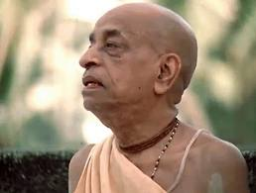
“My Dear Jayapataka,
…You have asked about the specialness of the month of Karttika, and the answer is that it is a special inducement for persons who are not in Krsna consciousness to perform some devotional service. For persons who are doing nothing in Krsna consciousness, it is an indirect inducement to take to devotional service in earnest seriousness, every moment is Karttika. In this connection, there is a good example that sometimes a store gives a special concession to attract new customers…”

Slide 12
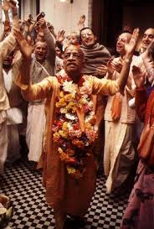
(Continued…)
But for those who are already customers there is no need of a special sale. They will purchase at any cost if they know the important value of the goods. Similarly, those who are pure devotees do not aspire for any concession, and out of spontaneous love try to engage themselves in devotional service twenty-four hours each day, three hundred and sixty five days every year, without any stoppage…”

Slide 13
Weekly Checklist for Purusottama Month
Week One | Wed | Thurs | Fri | Sat | Sun | Mon | Tues | Weekly Totals
Mangal Arati
Tulasi Puja & Parikrama
*Japa (__ Rounds)
Extra Rounds
S.B. Class
**Offering 1-16 Items of Worship
***Ganga Bath
Offering Flowers
Offering Tulasi/ Manjaris
Sandhya Artik
Offering Lamp
Reading about Krishna (BG, etc.)

Slide 14
Continued…
_
Preaching Programs
Home Programs
Harinams
Books Distributed
Vaisnava Seva
Temple Seva
Bhajans/Sangas

Slide 15
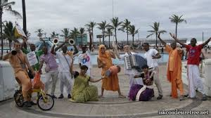
Purusottama Month Checklist Explanations
The recommendation for devotees during this month (and other similar ones) is to perform additional services and increase their chanting, hearing, reading, worship and, according to Srila Prabhupada, preaching to attract newcomers to the path of Krsna Consciousness. This merciful Purusottama Month is a very “special concession to attract new customers”. Since, according to Sastras, it is many times more beneficial than even Damodara month, it is a great opportunity to increase one’s spiritual advancement. There are essential and optional items in the given list.

Slide 16
Sri Krsna recommends in the Padma Purana:
Worshipping Him
Chanting His holy names
Studying Srimad Bhagavatam and Bhagavad-Gita
Offering ghee lamp (dipa) and
Giving in charity (best applied to devotees and by preaching Krsna Consciousness)

Slide 17
Srila Prabhupada’s Devotional Program
Several of the items indicated for observing Purusottama Month are included in the program (for morning and evening) that Srila Prabhupada prescribed for the devotees in ISKCON (waking up early, attending aratis, worshipping and circumambulating Tulasi devi, reading Srimad Bhagavatam, etc.). Thus by following this program, we are ensured to be already honoring some of the aspects for this particularly auspicious month.

Slide 18
Japa & Extra Rounds
For initiated devotees Srila Prabhupada recommended to chant extra rounds (above the minimum of 16) during special days such as Ekadasis.
For devotees involved in congregational programs having a system of gradually increasing their Japa (1, 4, 8, etc. up to 16 once aspiring for initiation) “extra rounds” means rounds above their established quota.
It is not intended that uninitiated devotes feel forced to chant 16 rounds without being voluntarily committed to do so.
In any case, to increase the quota of rounds during this month is suggested.

Slide 19
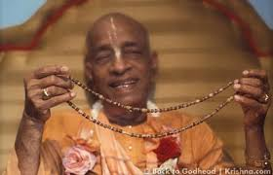
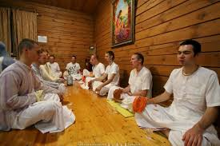

Slide 20
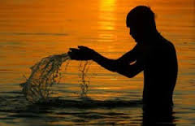
Ganges Bath
If unable to physically bathe in the waters of Mother Ganga, invoke her presence by repeating her name at least three times (“Ganga, Ganga, Ganga”). In this way Gangadevi would kindly manifest, and the given bath would be non-different from bathing directly in the waters of Mother Ganga.

Slide 21
Items of Worship (Upacaras)
During Purusottama month the worship of Krsna is particularly recommended. The observant of Purusottama month can choose from 1 to any number of these 16 items for their personal worship.
1. Seat (Asana) 2. Welcome (Svagata) 3. Lotus feet wash (Padya) 4. Sprinkle water (Arghya) 5. Water for sipping (Acamana) | 6. Special drink (Madhuparka) 7. Repeated water for sipping (Punar-acamana) 8. Bathing (Snana) 9. Fresh clothing, thread and tilaka (Vastra) 10. Ornaments and decorations (Abharana) | 11. Sandalwood paste (Gandha) 12. Fragrant flowers (Puspa) 13. Incense (Dhupa) 14. Ghee or camphor lamp (Dipa) 15. Foodstuff (Naivedya) 16. Respects (Pranams)

Slide 22
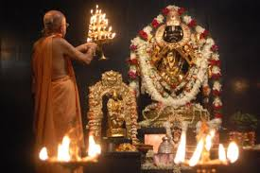
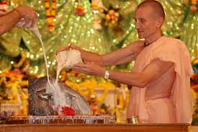

Slide 23
General Recommendations
Chanting extra rounds, helping guests to be engaged in some devotional practice and the offering of ghee lamps every day (in the same fashion of Damodara month) is particularly encouraged.
Other specifications found in different sastras may be followed according to the level of advancement of the practitioner.
The main encouragement is to especially attract new people by participating in preaching activities such as book distribution, home or public programs, Harinams, etc, to do some service for Krsna as recommended in the Padma Purana.

Slide 24
Srila Prabhupada Quotes & other references
“...And never neglect to chant your 16 rounds of beads daily, rise early without fail, attend Mangal Aratik, take bath, and follow the other regulative principles, and everything will come out very successfully, you can rest assured of that.”
(Srila Prabhupada’s letter to Bhargava dasa. LA June 13th, 1972) “…that enthusiastic mood is maintained when everyone is always without fail chanting 16 rounds daily, rising early for Mangal Aratik, reading books, preaching.”
(Srila Prabhupada’s letter to Trai dasa, Bombay India December 27th, 1972)

Slide 25
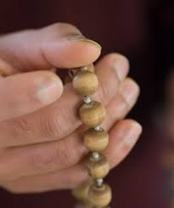
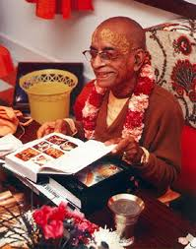
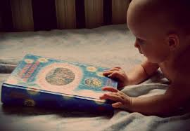

Slide 26
Srila Prabhupada on the importance of the Ganges
“…there is the story of Vāmana, who, when He took three steps, stuck His foot through the covering of this universe. Water from the Causal Ocean flowed through the hole that His foot made, and it is said that that water became the river Ganges. Therefore the Ganges is accepted as the most sacred water of Viṣṇu…” (From Srila Prabhupada’s Introduction to Caitanya Caritamrita)

Slide 27
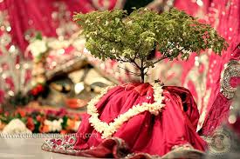
Tulasi Aratik
and Parikrama:
"…Simply by seeing, simply by touching, simply by remembering, simply by praying to, simply by bowing before, simply by hearing about, or simply by sowing the tree, there is always auspiciousness. Anyone who comes in touch with the Tulasi tree in the above mentioned ways lives eternally in the Vaikuntha world." (Srila Prabhupada’s letter to Radhavallabha dasa. Bombay January 6, 1972). “Whoever takes shelter of you has his wishes fulfilled. Bestowing your mercy on him, you make him a resident of Vrindavan.”- Krsna Das (Tulasi Arati Song)

Slide 28
Offering of 1 to 16 items of worship (Upacaras):
“The offerings of Upacaras are the medium by which you can express your devotional service. Bhakti, your love is one Upacara and the best of all Upacaras. If something is offered with bhakti it is considered as bhakti. If it is offered with the intention of gaining some fruitive result it is mixed bhakti.” - H.G. Jananivas Prabhu, Head Pujari of ISKCON Mayapur and Head of ISKCON Deity Worship Division For more information on Upacaras please visit www.deityworship.com

Slide 29
Vaisnava Seva
Srila Narottama dasa Thakur says, “chadiya vaisanva seva nistara peyeche keba”: unless one serves a Vaisnava, he cannot be delivered.”- CC Madhya 1.218 ppt Lord Siva tells his wife: “My dear Pārvatī, there are different methods of worship, and out of all such methods the worship of the Supreme Person is considered to be the highest. But even higher than the worship of the Lord is the worship of the Lord’s devotees.” (Padma Purana)

Slide 30
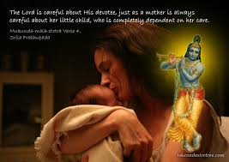
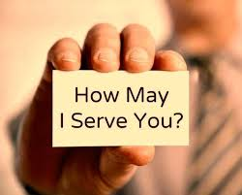
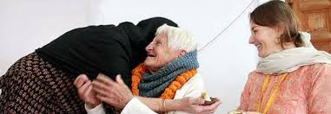

Slide 31
Temple Seva
“…But those who are not doing, for them it is very difficult. Kṛṣṇa says... He gives the prescription that satataṁ cintayanto mām: (BG 9.14) "Always thinking of Me." Man-manā bhava mad-bhakto mad-yājī māṁ namaskuru (BG 18.65). Here is the chance. You come to the temple, engage in the temple service. Naturally your mind will be absorbed in Kṛṣṇa. This temple is open not for making a force; just to make this process, niveśita-ātmā, always absorbed in Kṛṣṇa thought.
(Srila Prabhupada Lecture on SB 1.15.33 – Los Angeles, December 11, 1973)

Slide 32
The Greatest Charity in the world
“As far as charity is concerned, it is plain that charity should be given to the devotees of Kṛṣṇa who are engaged in His devotional service to spread the Kṛṣṇa philosophy, or Kṛṣṇa consciousness, throughout the world. Kṛṣṇa consciousness is a benediction to humanity. Lord Caitanya was appreciated by Rūpa Gosvāmī as the most muniﬁcent man of charity because love of Kṛṣṇa, which is very difﬁcult to achieve, was distributed freely by Him. So if one gives some amount of his money to persons involved in distributing Kṛṣṇa consciousness, that charity, given to spread Kṛṣṇa consciousness, is the greatest charity in the world.” (Bg. 11.54 ppt)

Slide 33
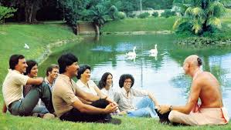
Preaching
The Lord Himself states in the Gita (18.68–69), “For one who explains this supreme secret to the devotees, devotional service is guaranteed, and at the end, he will come back to Me. There is no servant in this world more dear to Me than he, nor will there ever be one more dear.”

Slide 34
Benefits of Observing
Purusottama Vrata All the holy places in the world come to reside in your body.
One who observes Purusottama Month with faith and devotion will go back home, to serve Radha-Govinda eternally in Goloka Vrndavana at the end of his life.

Slide 35
How to conclude the Purusottama Vrata
Worship Radha-Govinda and chant this mantra:
“O Supreme Lord! O Sanatana! O Purusottama! O Lord Hari! I offer my obeisances unto You. May You and Your beloved Srimati Radhika please accept my offerings. I offer my repeated obeisances unto Radha-Syamasundara, who wears effulgent yellow garments on His beautiful body.”
Offer pushpanjali and dandavats to Radhe-Syama.
Give charity and feed to brahmanas to best of your ability.

Slide 36
Please contact us at:
Email: cdmofficeiskcon@gmail.com
www.iskconcongregation.com
Facebook
ISKCON Congregation
ISKCON Mayapur
Chakra Building, office 127-128

