Slide 1
CDM PROGRAM
THE SIX C’S
BY JAYAPATĀKĀ SWAMI

Slide 2
from contact to complete perfection

Slide 3
6 C’s of Preaching
CONTACT
CULTIVATE
CONGREGATE
COMMIT
CREEPER GROWTH
COMPLETE PERFECTION

Slide 4
CONTACT

Slide 5
CONTACT
Temple Programs or Visits
Festivals
Book Distribution
Bhakti Groups
Campus Preaching or Outreach
Prison Inreach
Friends & Relatives
Work Colleagues, Students
Neighbors

Slide 6
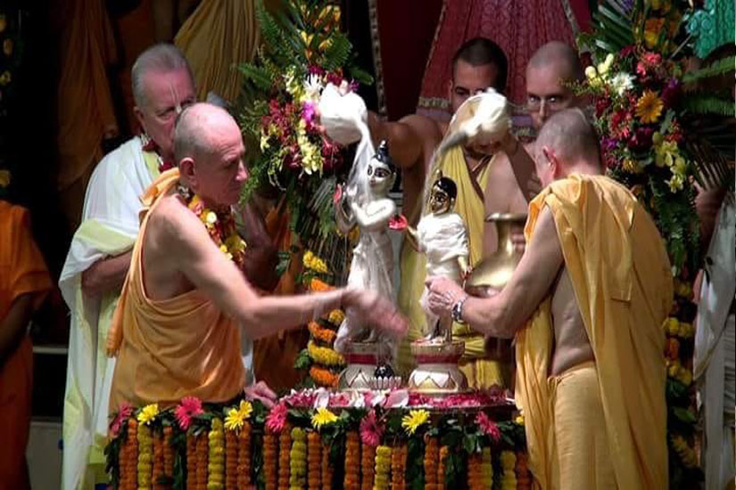
Contact – Temple Programs, Festivals

Slide 7
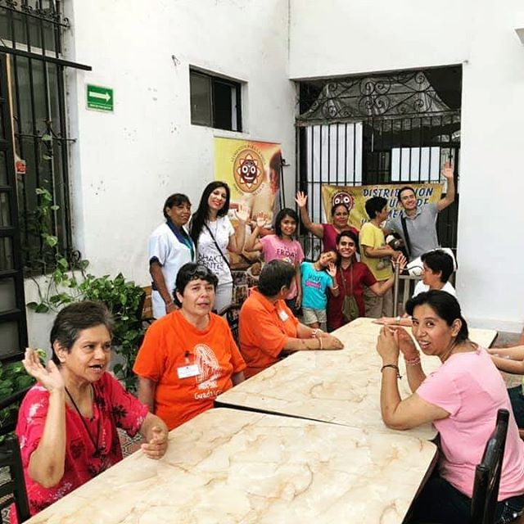
Contact – Book Distribution, Bhakti Groups

Slide 8
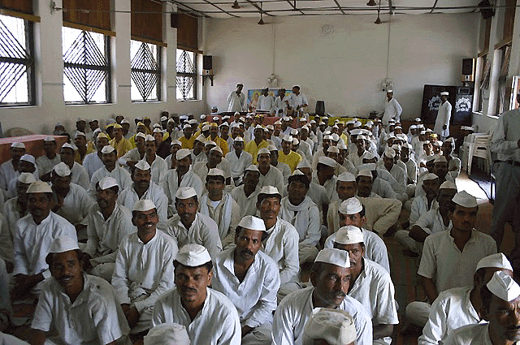
Contact – Outreach: Campus, Prison INREACH

Slide 9
Contact – Friends, Colleagues, Relatives

Slide 10
CONTACT
Get their Contact Details
Get them interested in Krishna Consciousness Programs

Slide 11
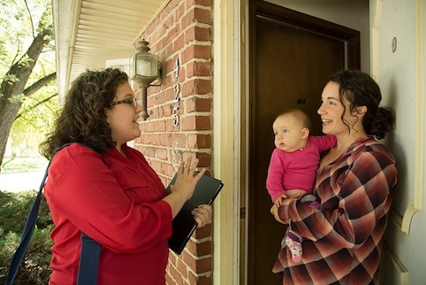
Contact – Get details create Interest

Slide 12
CULTIVATE

Slide 13
CULTIVATE
Connect with Congregation
Lord Chaitanya’s Request –
Chant Krishna’s Name
Do Krishna’s Service
Study Krishna’s Teaching (Study BG, SB, CC and follow them)
Communicate to Increase Faith
Communicate to Connect
Bridging courses

Slide 14
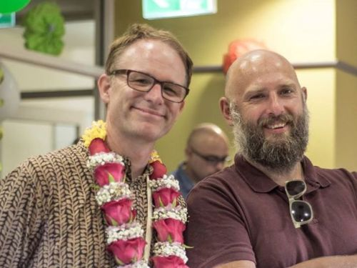
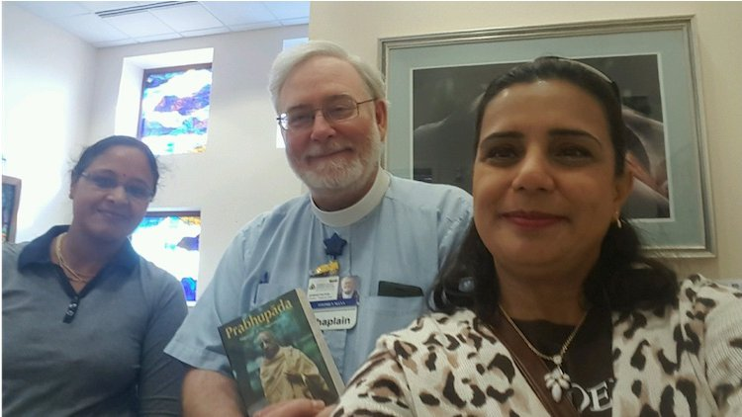
Cultivate – Connect with Congregation

Slide 15
Cultivate – Bridging Courses

Slide 16
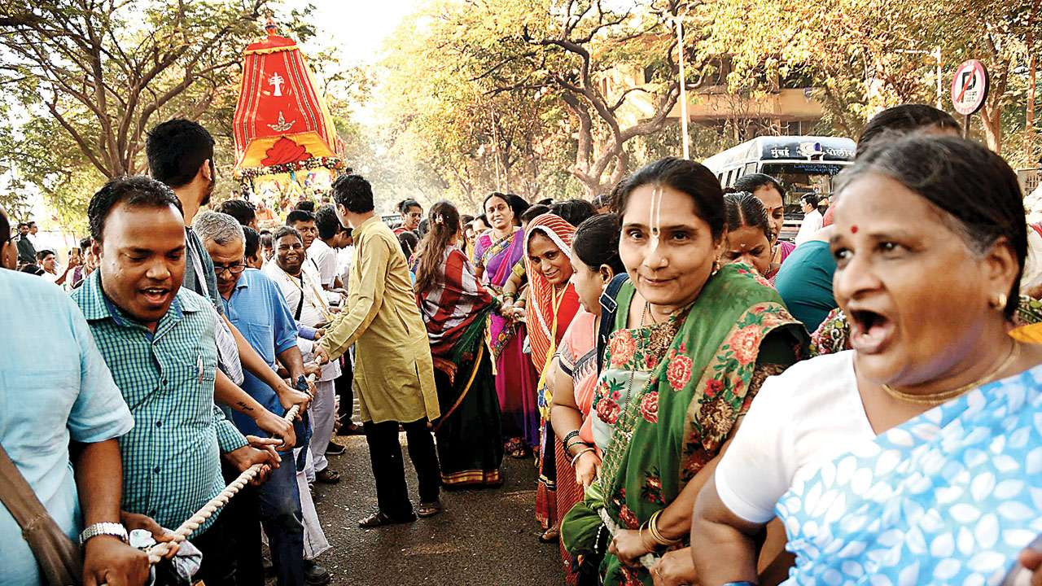
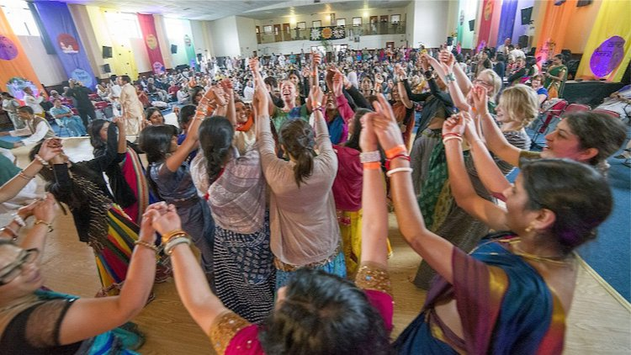
Cultivate – Increase faith and connect

Slide 17
CULTIVATE
Chant Krishna’s Name
Pancha Tattva Mantra
Hare Krishna Maha Mantra
Do Krishna’s Service
9 processes of Devotional Service
All of them or any

Slide 18
Cultivate – Chanting & Devotional Service

Slide 19
CONGREGATE

Slide 20
CONGREGATE
Congregation belongs to a Bhakti Group
Bhakti Vriksha
Congregation Group
Namahatta Group
ISKCON Youth Forum
Shastras Study Group
Send Children to Weekend KC Schools
OFFENSIVE CHANTING
BHAKTI HOMES

Slide 21
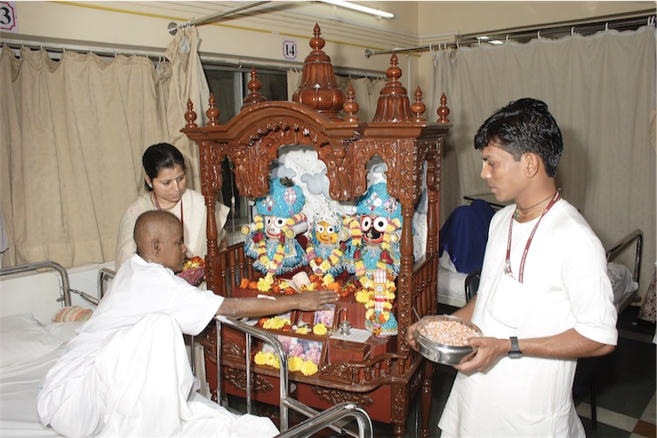
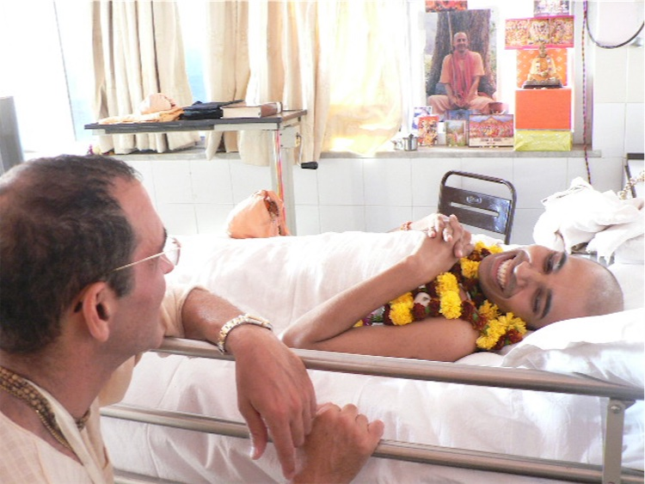
Congregate – Programs in Hospital

Slide 22
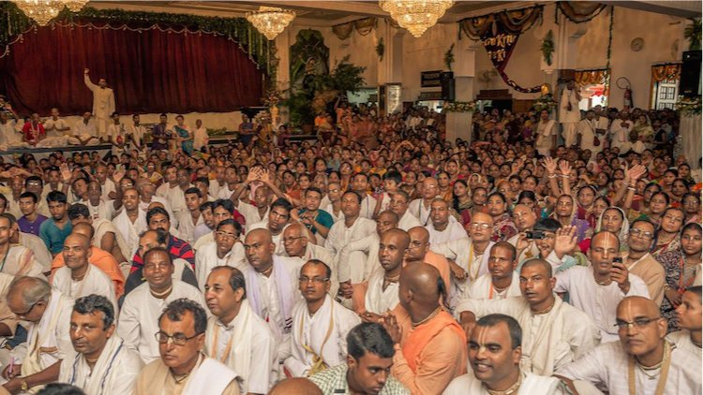
Congregate - Bhakti Groups

Slide 23
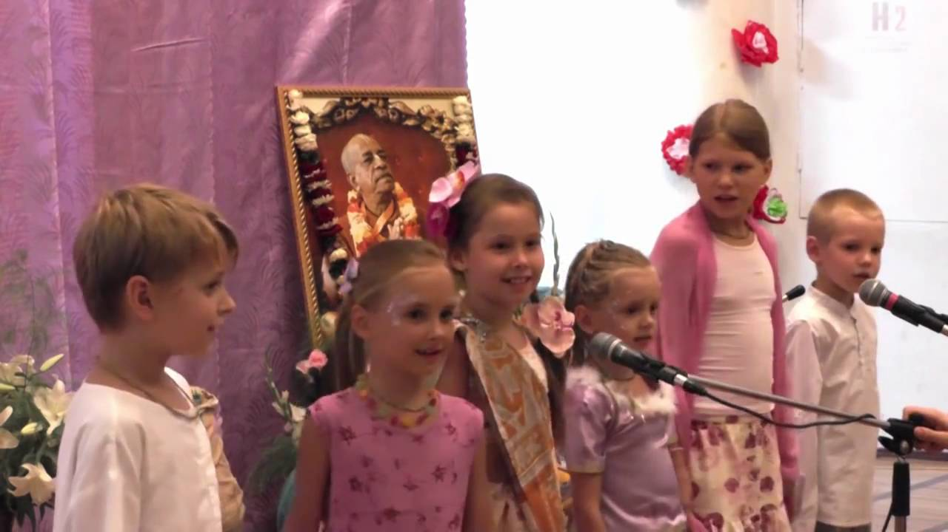
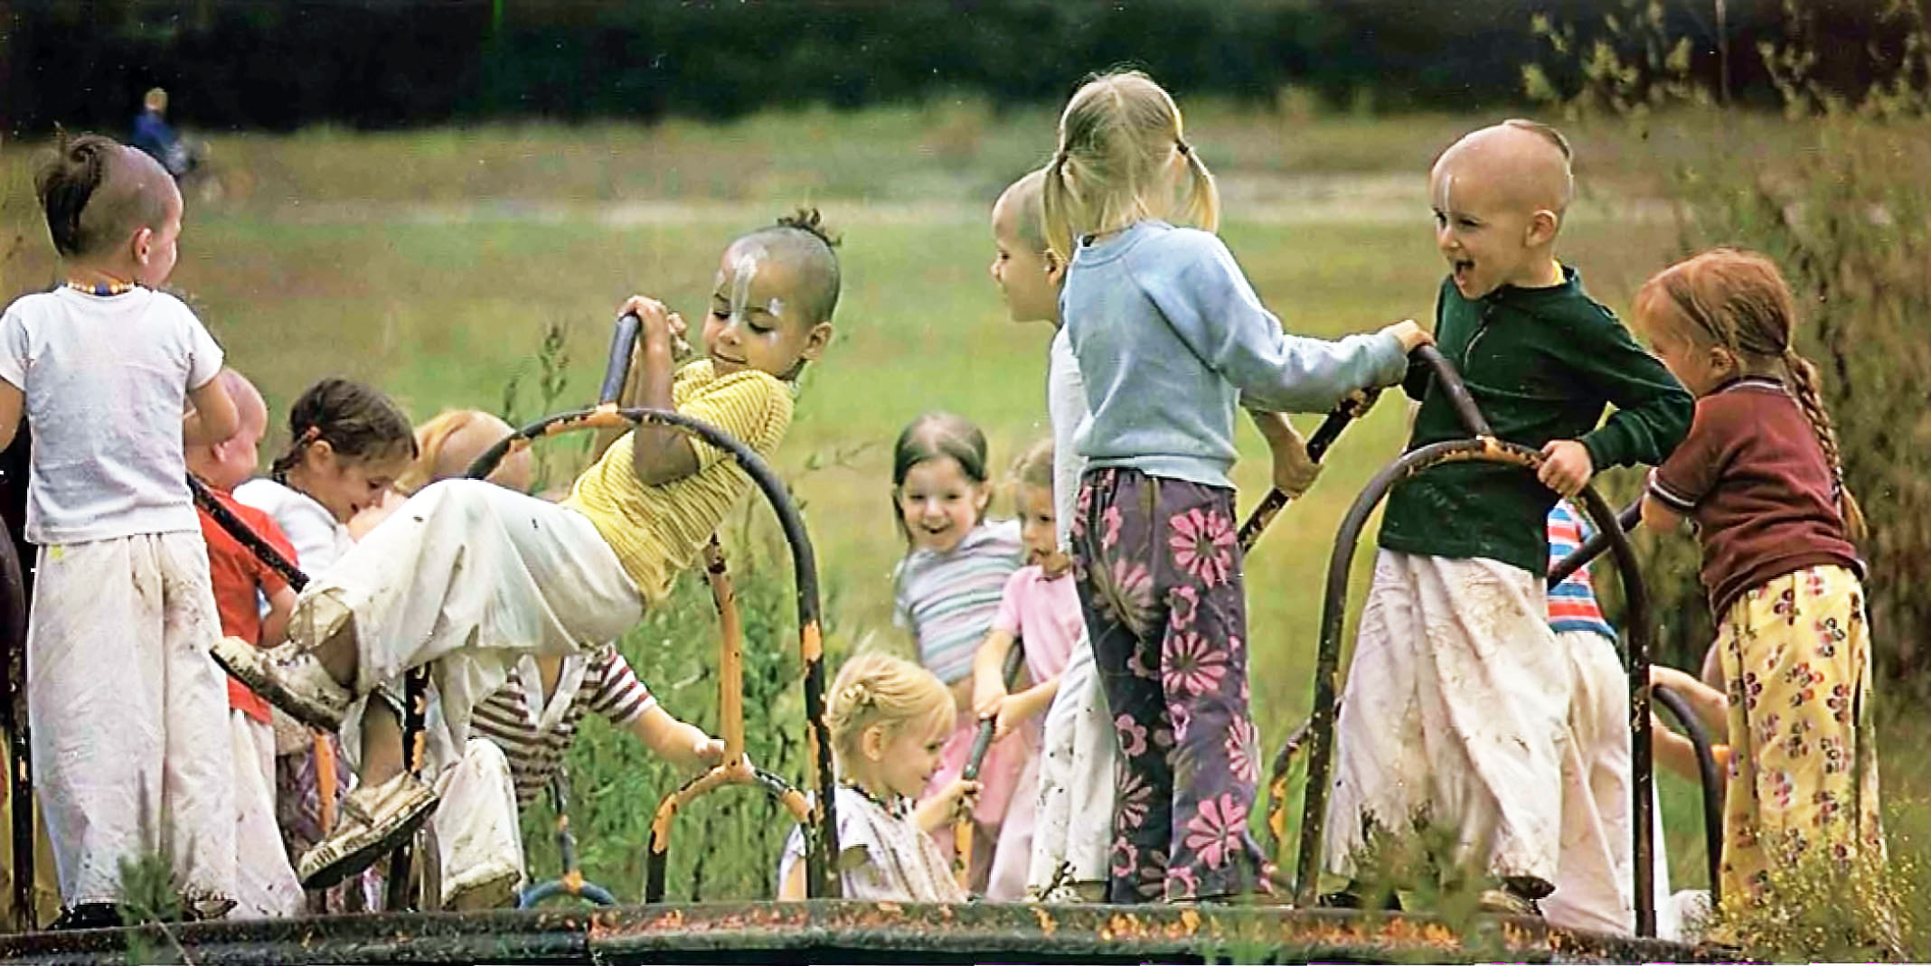
Congregate: Weekend Children Program

Slide 24
CONGREGATE
Participate in Prison Inreach Program
Outreach Programs in Hospitals
Support Temples and / or Bhakti Group financially or with service
Participate in Festivals
Observe Holy Days

Slide 25
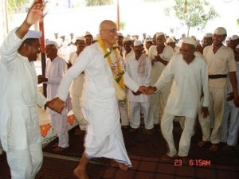
Congregate: Participate in Prison Inreach

Slide 26
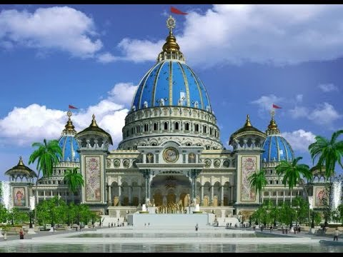
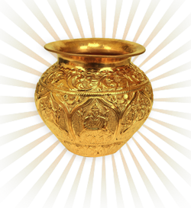
Congregate: Support Temple

Slide 27
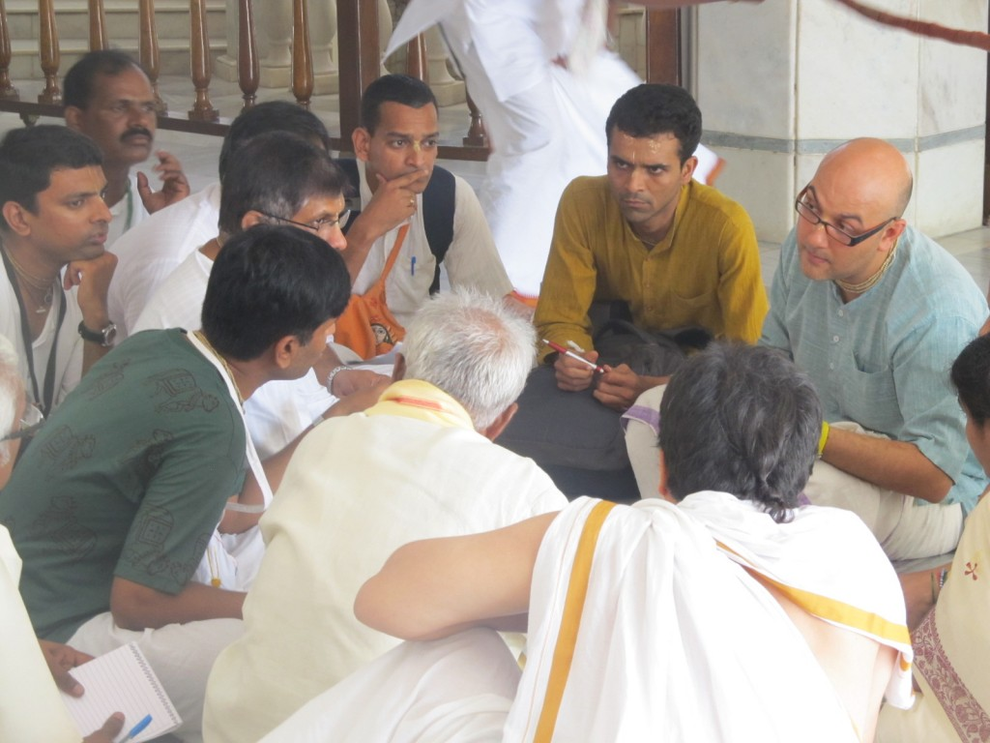
Congregate: Support Bhakti Group

Slide 28
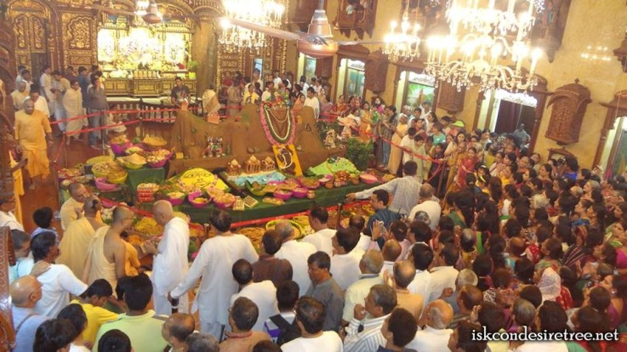
Congregate: Festivals & Holy Days

Slide 29
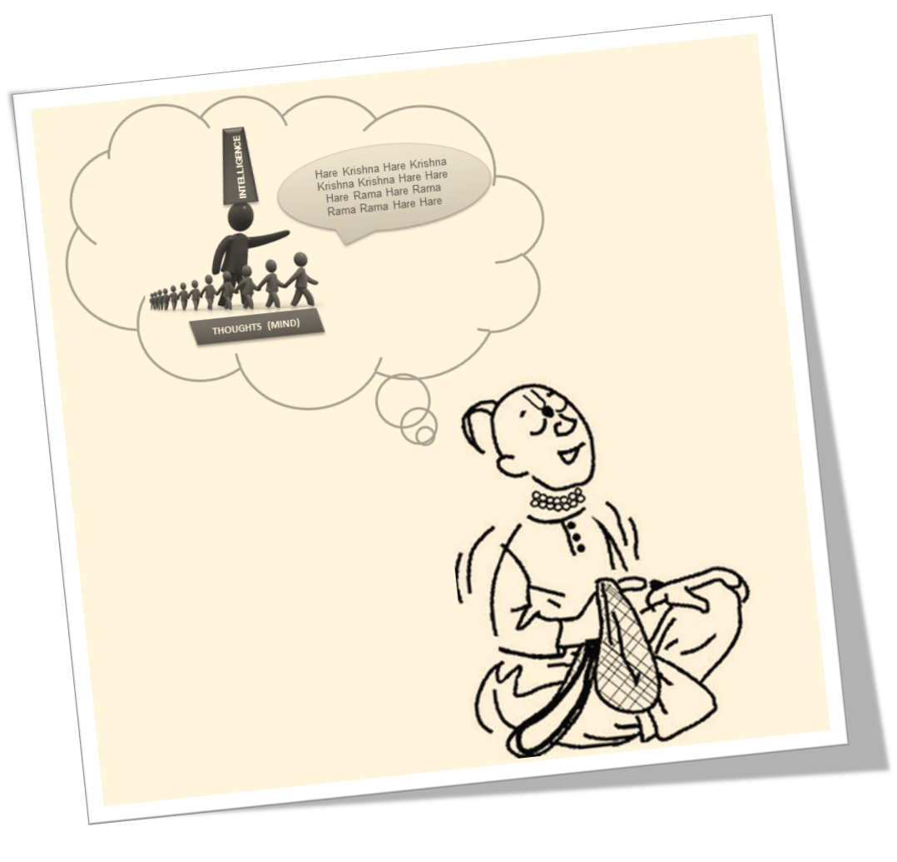
Congregate: Bhakti Ladder
Srraddhavan (1 round)
Krsna Sevak (4 rounds & veg)
Krsna Sadhaka (8 rounds & regulative principles)

Slide 30
COMMIT

Slide 31
COMMIT
Commitment to Guru Parampara
Srila Prabhupada Ashray – Chanting 16 rounds and following 4 Regulative Principles
Guru Ashray – Same as Srila Prabhupada Ashray but choosing a particular Guru
CHANTING CLEARING

Slide 32
COMMIT
Initiation – Taking vows to chant 16 rounds, follow 4 regulative principles and serve Guru whole life
Take up some regular temple service (management, committee member for festival or some department, separate leadership for Bhakti Group

Slide 33
Commit: Initiation – Vows, Service to Guru

Slide 34
COMMIT
Teach Children, Youth
Organize Outreach Programs – Damodar, Festival’s etc
Help in Prison Inreach
Regular Donations
Pre Marital Training

Slide 35
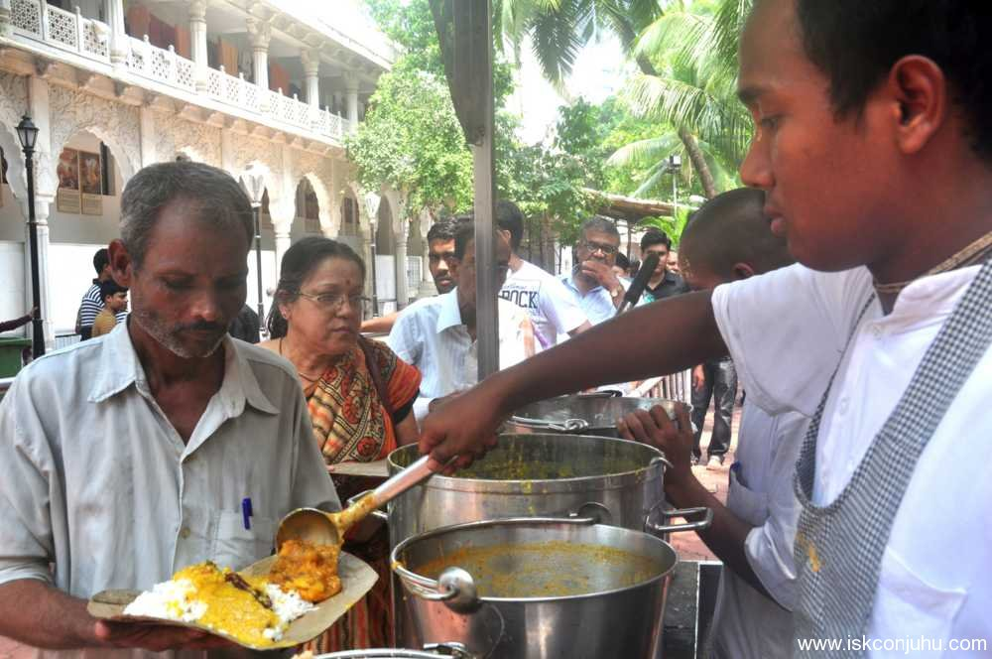
Commit: Render some regular service

Slide 36
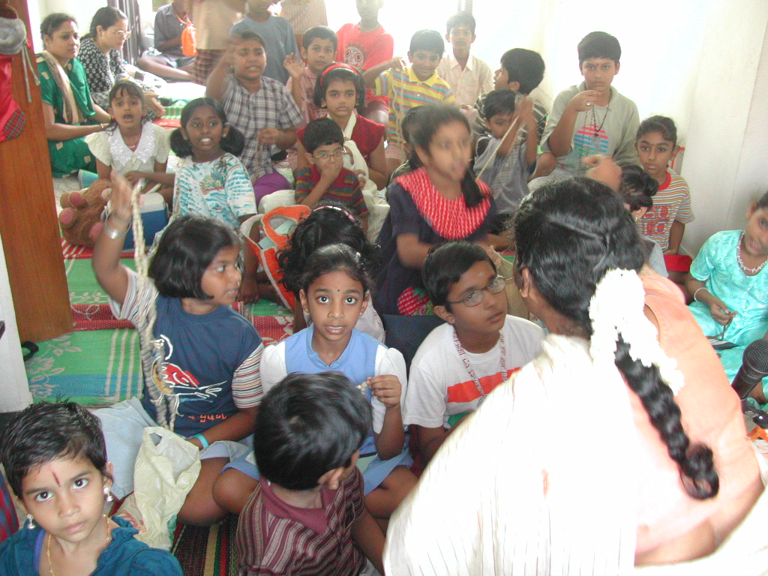
Commit: Preaching programs

Slide 37
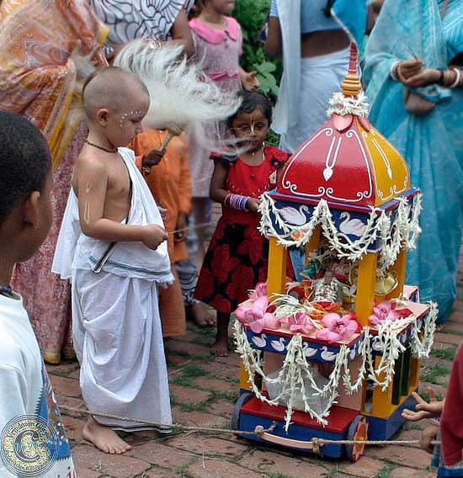
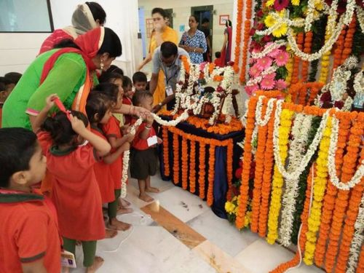
Commit: Outreach – Festivals & Holy Days

Slide 38
Commit: Training Course

Slide 39
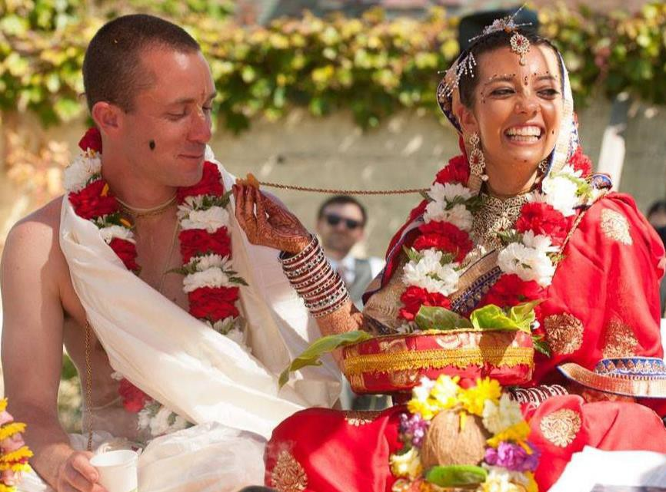
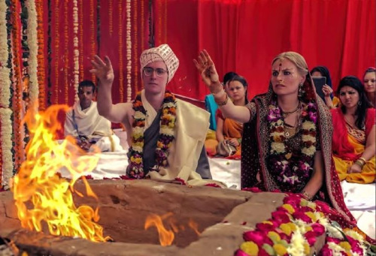
Commit: Marrying a Devotee

Slide 40
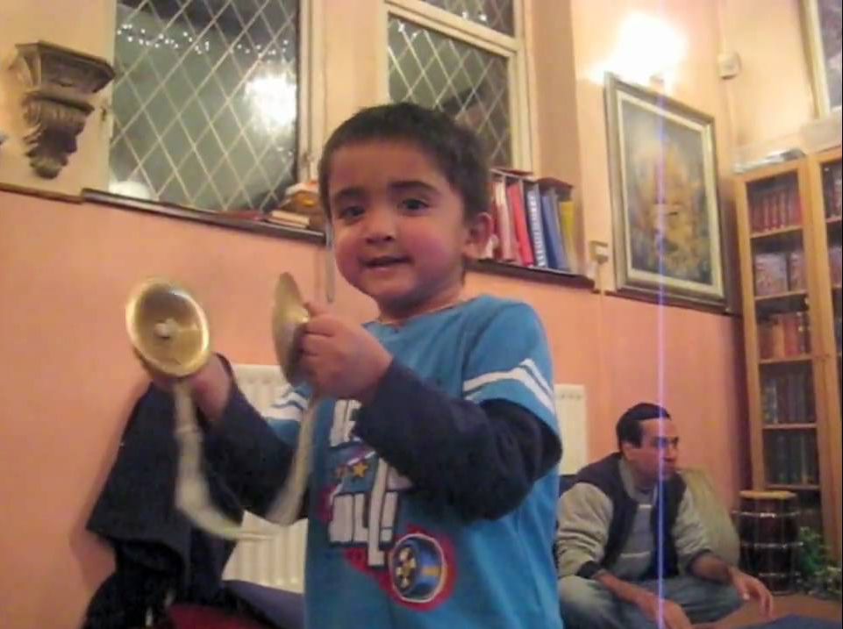
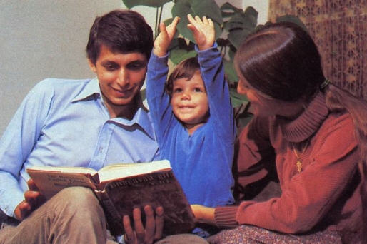
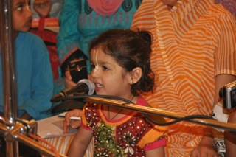
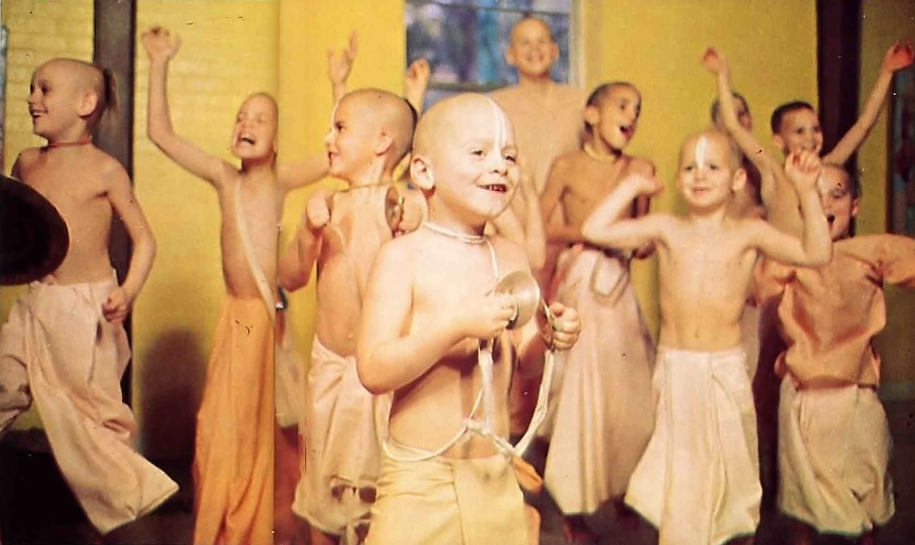
Commit: Raising a Krishna Conscious Child

Slide 41
COMMIT
Commit to make further Progress
Make further advancement – climbing the Bhakti Ladder

Slide 42
Commit: Progress in Bhakti Yoga
bhajana-kriya
anartha nivrtti
nistha
ruci
asakti

Slide 43
CREEPER GROWTH

Slide 44
STAGE BETWEEN ANARTHA NIVRITTI AND RUCHI
IMBIBE VAISHNAVA CULTURE AND SERVICE ATTITUDE
INCREASE AFFECTION FOR KRISHNA
DECREASE MATERIAL DESIRE AND INCREASE SPIRITUAL DESIRE
RESPECT THE VAISHNAVAS
FREE FROM OFFENCES
ACHIEVE OFFENCELESS CHANTING
FOLLOWING THE BRAHMACHARYA STRICTLY OR RESPONSIBLE GRAHASTA, TAKING VANPRASTHA AND ACCEPTING SANYASA
PULLING THE WEEDS OUT
PHILOSOPHICAL ENHANCEMENT OR GROWTH

Slide 45
COMPLETE PERFECTION
Pure Love of Krishna
Realization of your Eternal Identity
Going back to Godhead
Participating in Krishna’s Eternal Pastimes

Slide 46
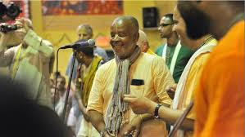
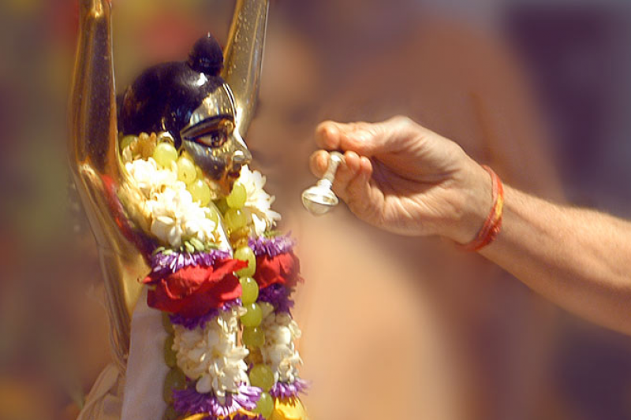
Complete Perfection: Pure Love of Krsna

Slide 47
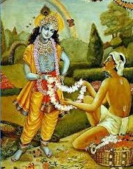
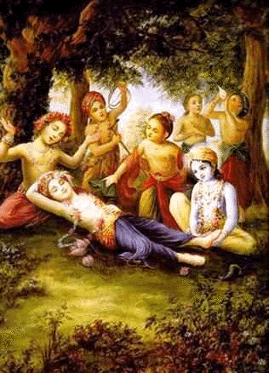
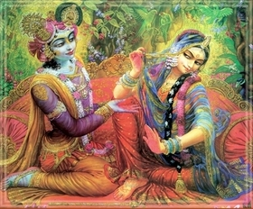
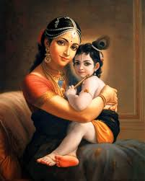
Complete Perfection: Going back to Godhead

Slide 48
Hare Krishna
THANK YOU!

